Slide 1

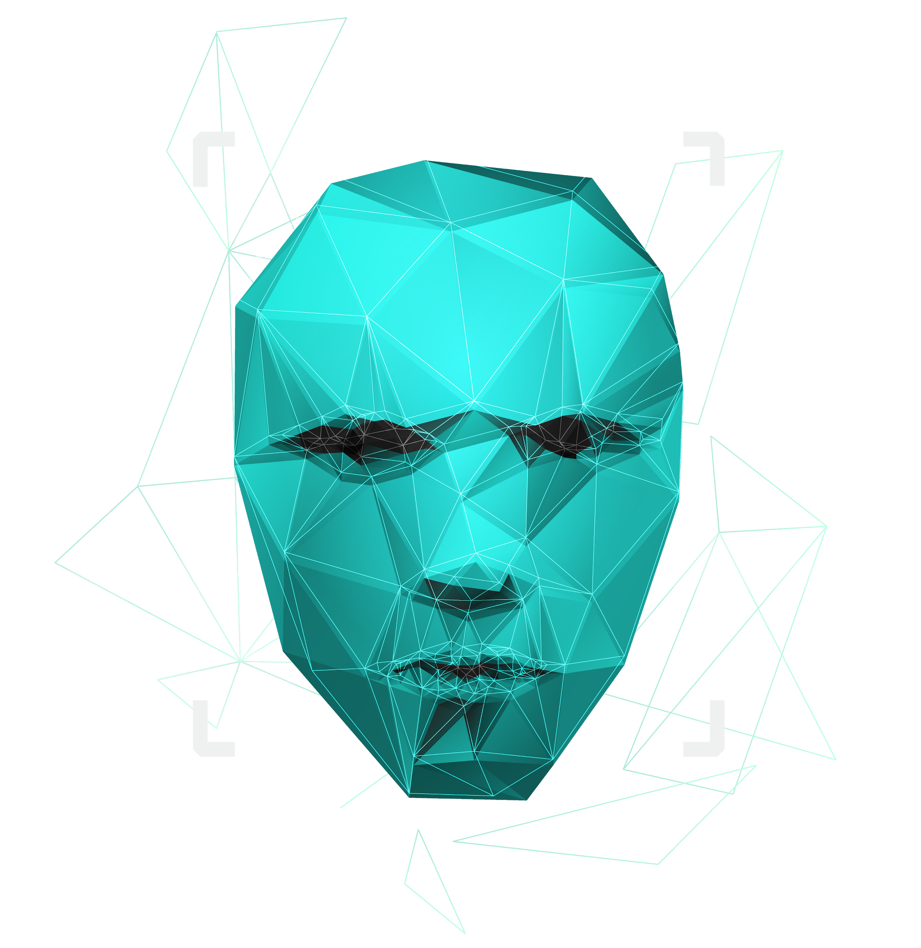
Paternity testing using genetics
Supervised by : Dr. Ashraf Abdelraouf & Eng. Ahmed Hazem

Slide 2

Agenda
Introduction
Problem Statement
Our Objectives
System Overview
Use-case Diagram
Functional Requirements
Non-Functional Requirements
Class Diagrams
Data Design (Database & Dataset)
Time plan
Live Demo

Slide 3

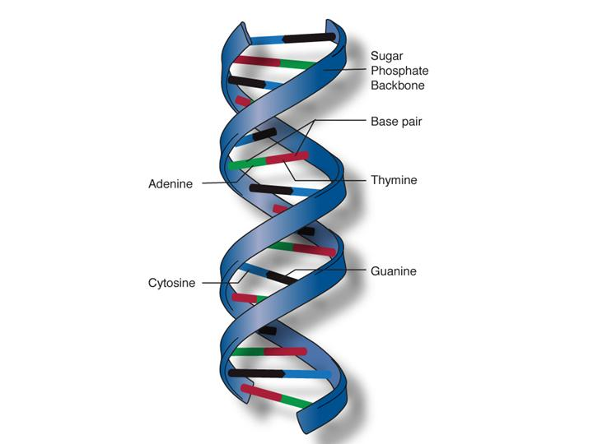
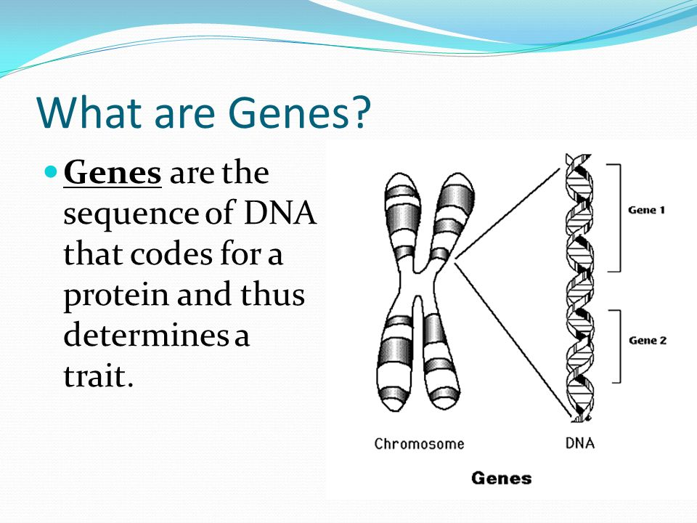
Introduction
DNA
DNA molecules allow this information to be passed from one generation to the next.
Genes →Genes are passed from parents to offspring and contain the information needed to specify traits(qualities). Genes contains a subset of the DNA and this subset is (A, T, C, G).

Slide 4
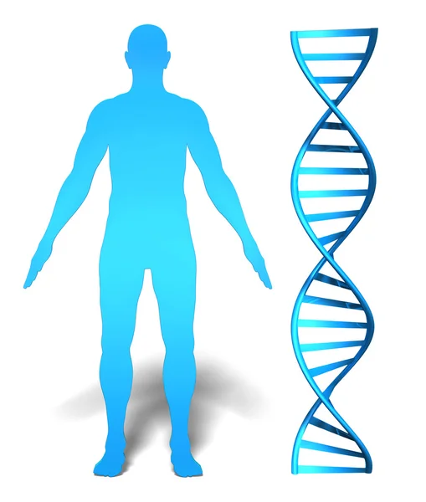
Introduction (cont.)
Whole genome
It is the whole DNA sequence that a human have in their system.
Whole exome
It is a part of the whole genome and makes up to 1.5% of it and it may reveal information about family relationships (ex: paternity test)

Slide 5
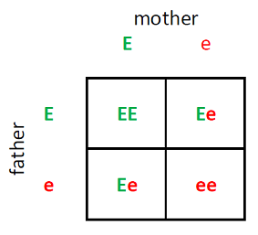
Introduction (cont.)
What is an rsNumebr?
It is a reference number to the gene we have that consists of two alleles (one from the father and the other from the mother).
EX:
RsNumber | Father | Mother | Child1 | Child2 | Child3
rs3131972 | AG | GG | AG | GG | GG

Slide 6


Problem Statement
Some parents suffer from the process of paternity testing when they are being sued for child custody.
A lot of time when a crime happens, some DNA would be left at the crime scene and would take some time to be processed and eventually lead us to the one who committed that crime.
Why can’t we have a system that could potentially prove this in less time and be accessible to everyone.

Slide 7
Our Objectives
Make an automated system to accurately prove parentage of someone by their rsNumbers and their genotypes.
Add another part to enter the user’s whole genome or whole exome.
We aim to have the application accessible by everyone by an online web application.
We aim that the user can see which alleles contributed to being wrong that led to prove wrong parentage.

Slide 8
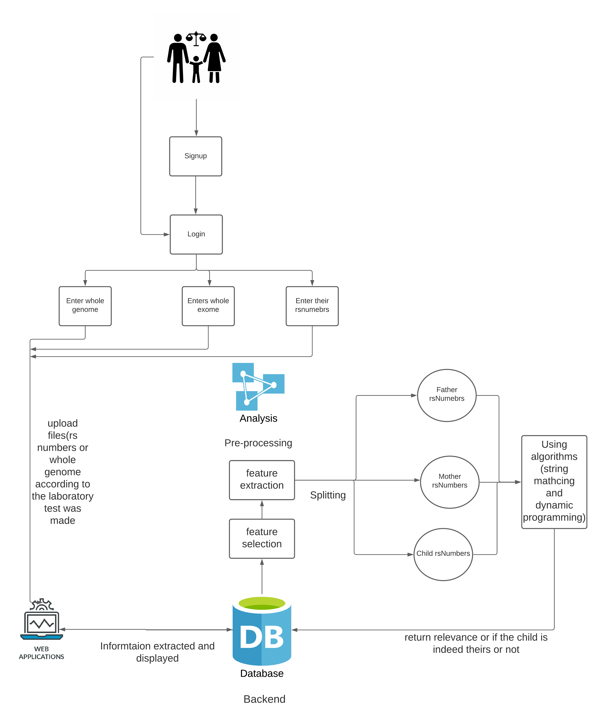
System overview

Slide 9
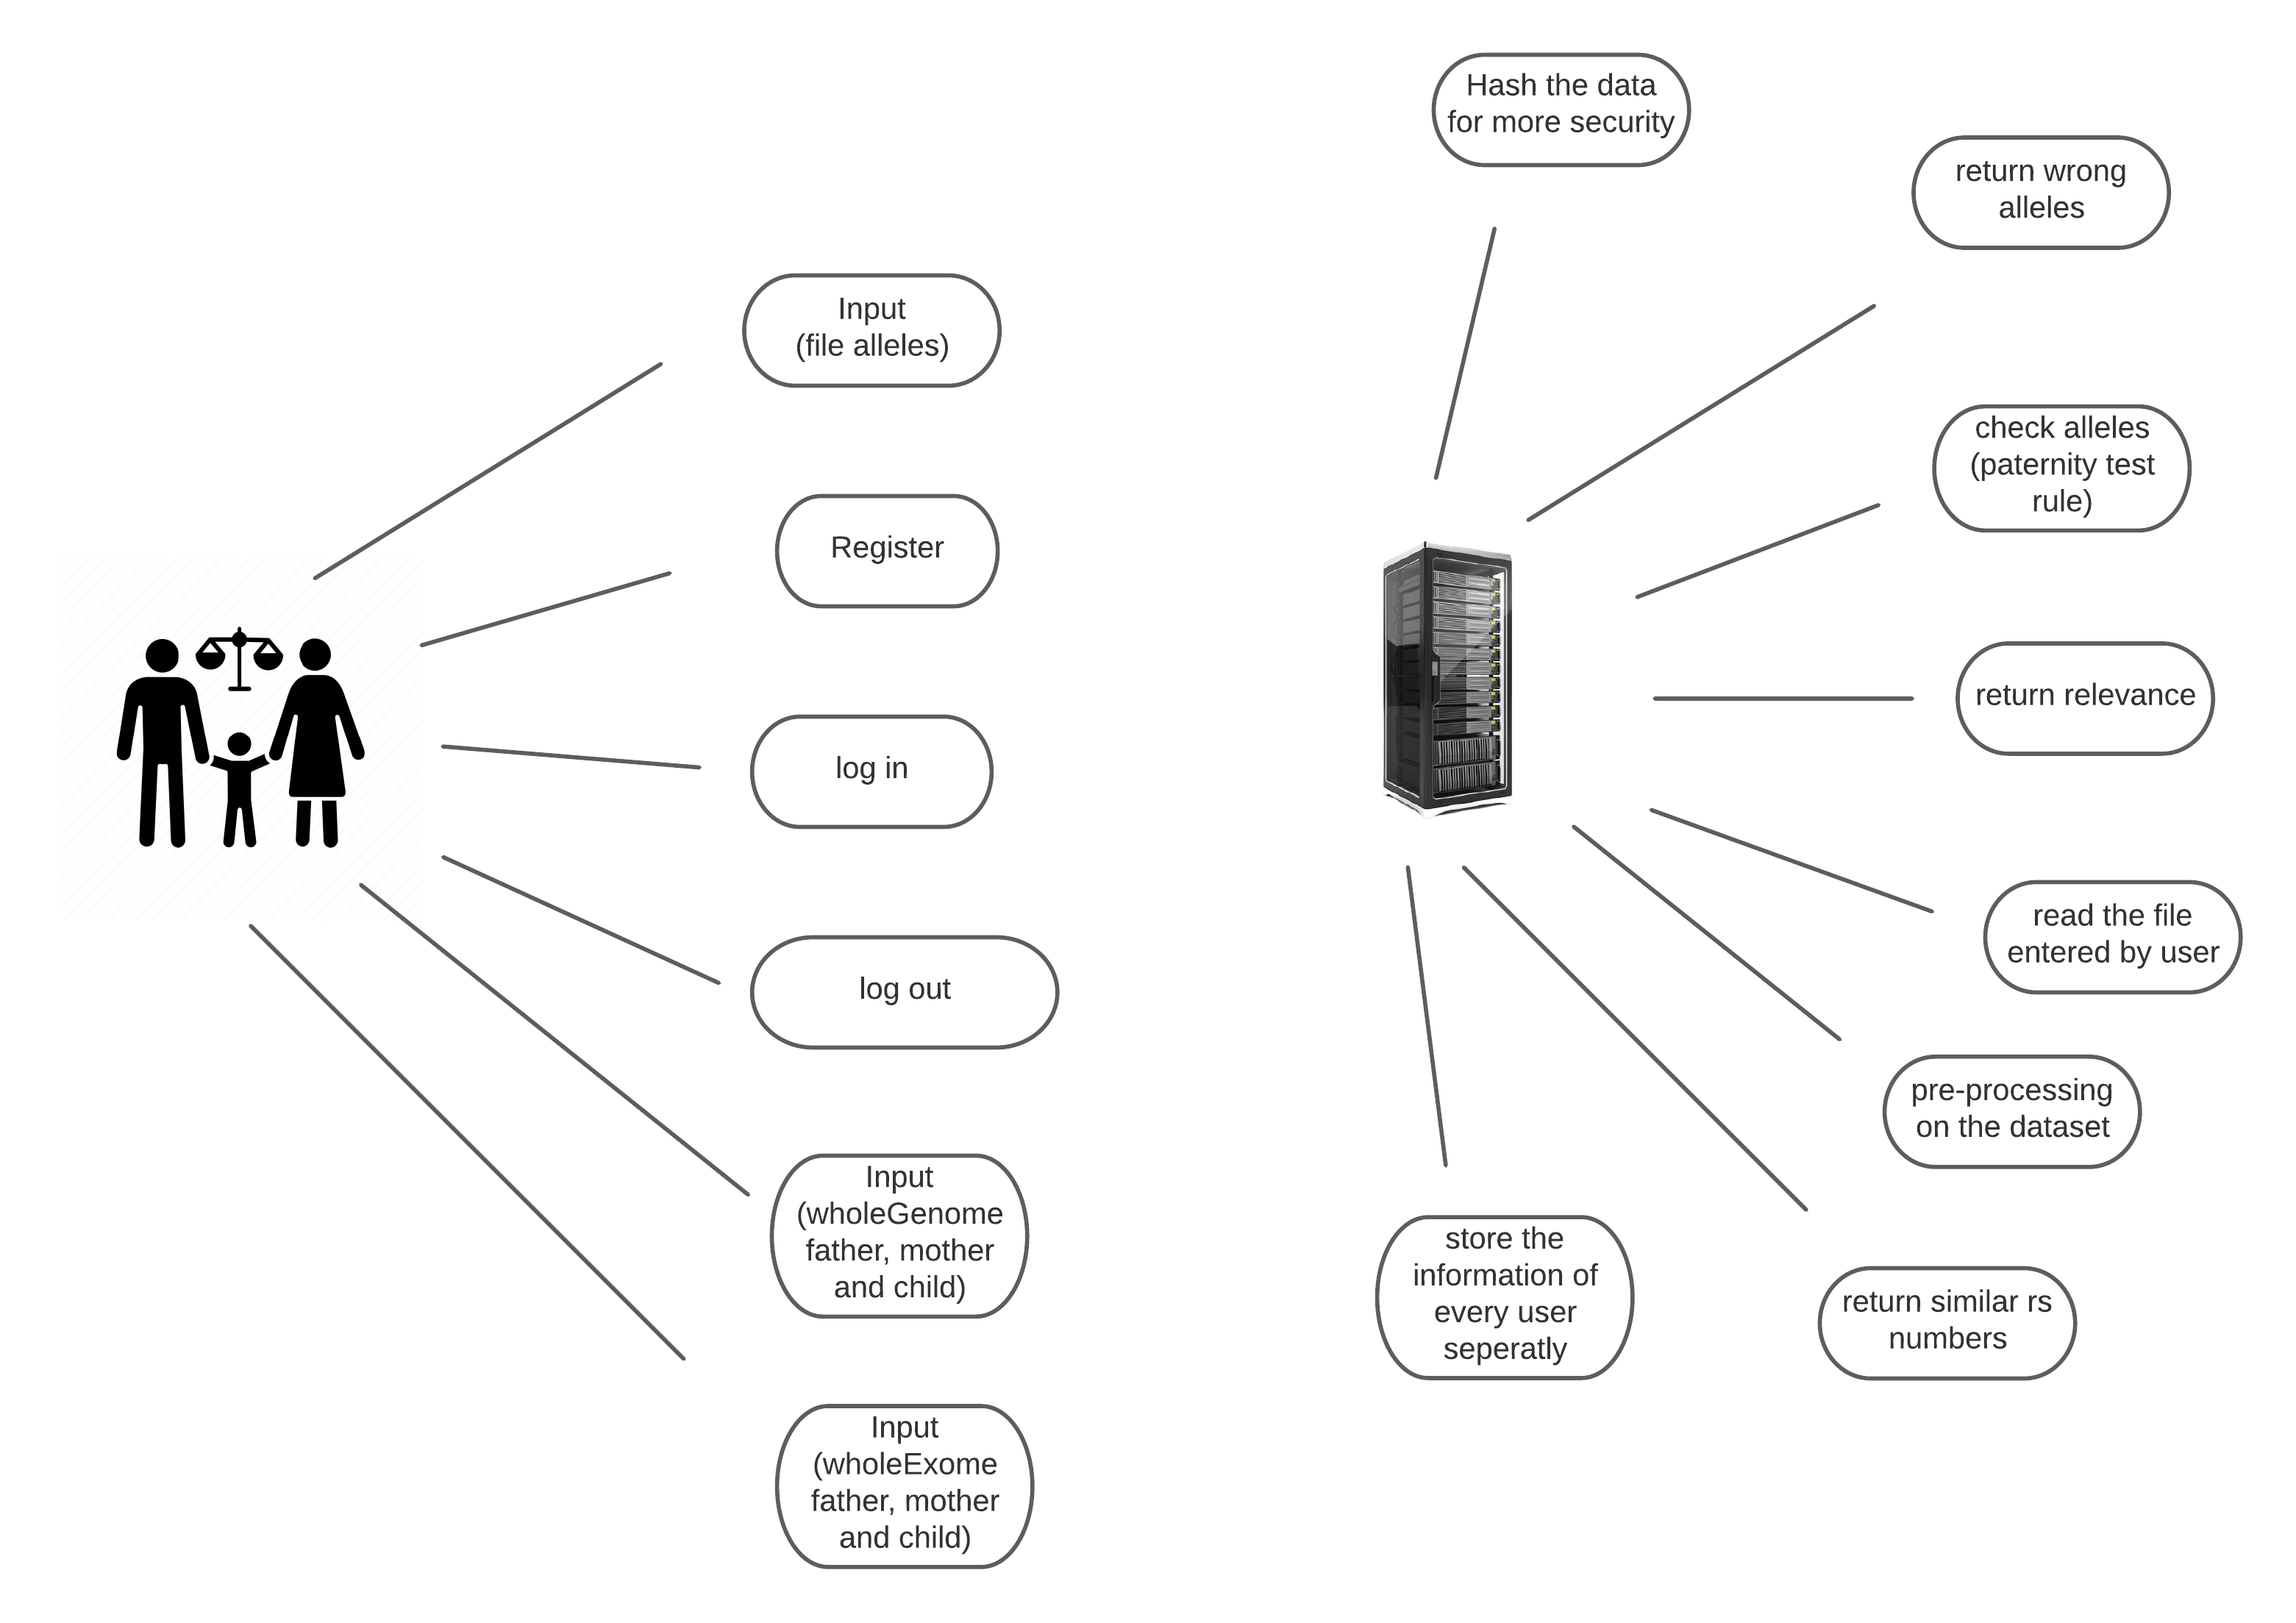
Use Case Diagram & Functional Requirements
The system can accept files from the user containing their genotypes.
The system can save the user’s data (genotypes) (results)
The user can input their genotypes and get a report showing which genotypes contribute to the paternity test.
The user can see which alleles are different if it was proven wrong.

Slide 10
Non-Functional Requirements
Safety: The system will detect any attacks and it should be secure
Availability: The system should be available at any time without any failure.
Scalability: our system is able to increase its capacity and functionalities based on the users demand. it can remain stable while adapting to changes and upgrades

Slide 11
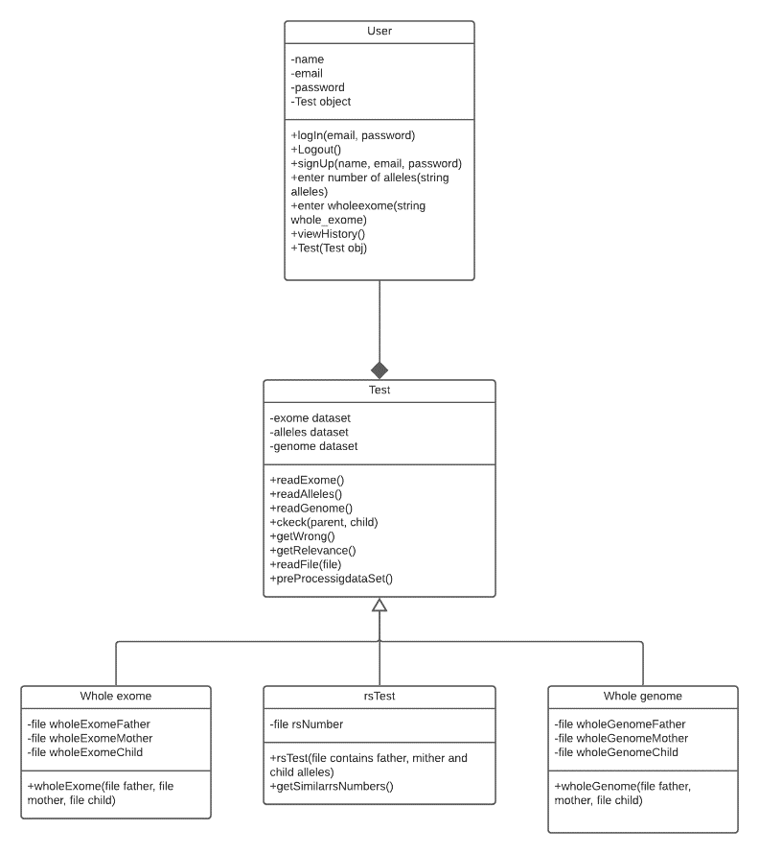
Class diagram

Slide 12
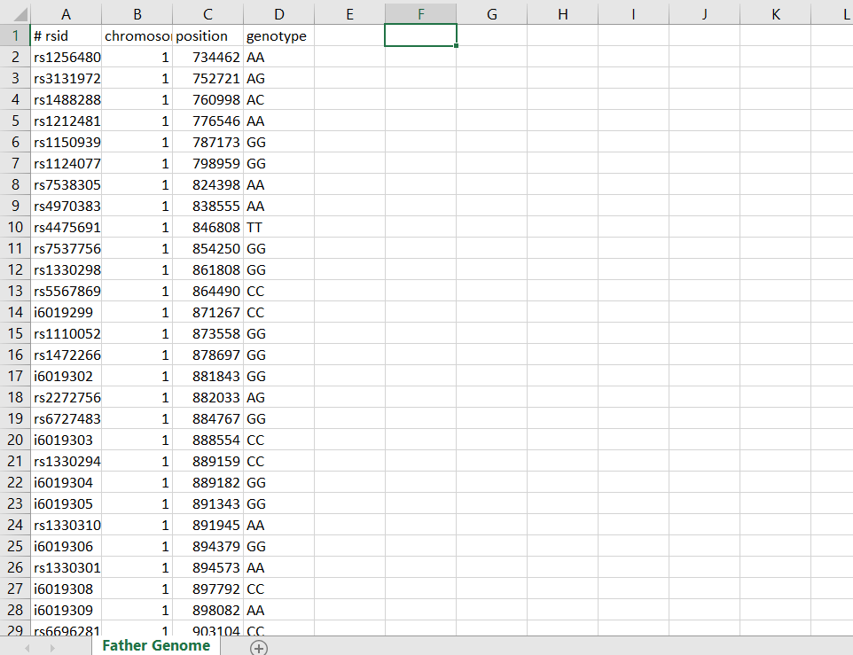
Data design (database & dataset)
Our dataset consists of several rs numbers containing the genotypes of each member

Slide 13
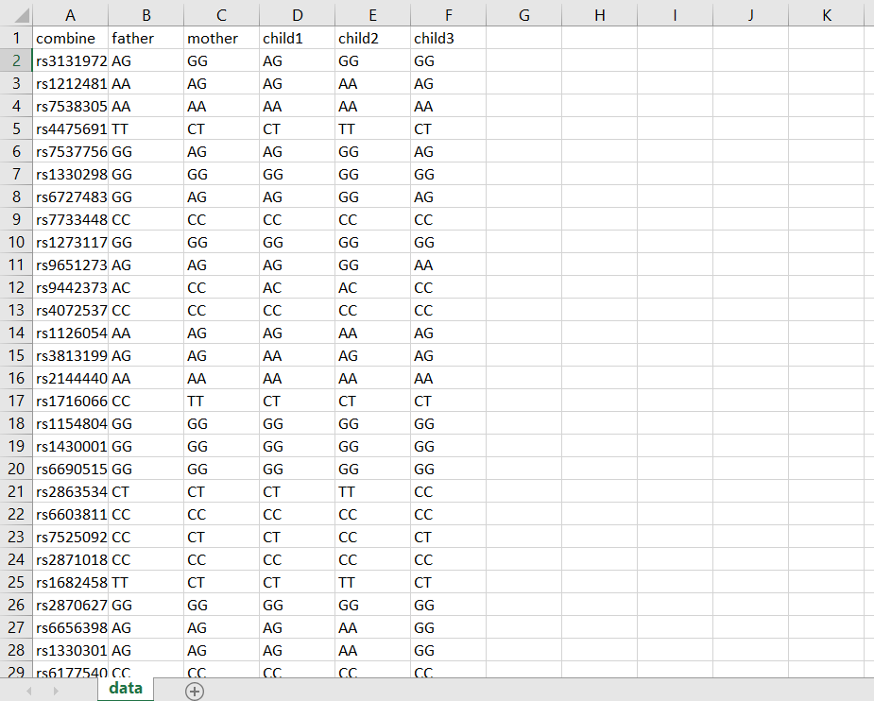
Data design (database & dataset) (cont.)

Slide 14
TIME PLAN
13/1/2022
Enhance everything we implemented so far
Whole genome processing from the sources we gathered
By the end of January
Potentially add Whole exome in our system based on the information we gathered
By the end of February
Implement at least 60 % of the web application
Before the end of Februrary
Start by the end of February
Prove that if is at least a relevance or kinship degree

Slide 15
Live Demo

Slide 16
THANKS!
Do you have any questions?
youremail@freepik.com
+91 620 421 838
yourcompany.com
Please keep this slide for attribution.

